Slide 1
What is a distribution?

Slide 2
What is a distribution?
How often do certain values occur?

Slide 3
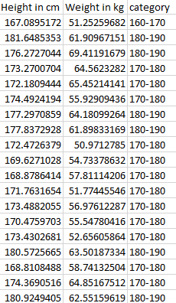

Slide 4
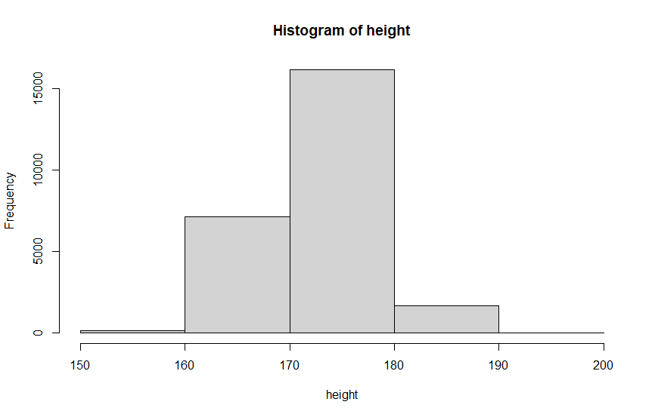

Slide 5
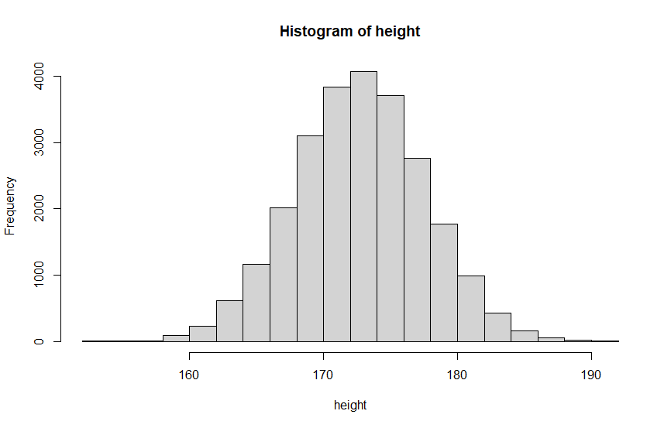

Slide 6
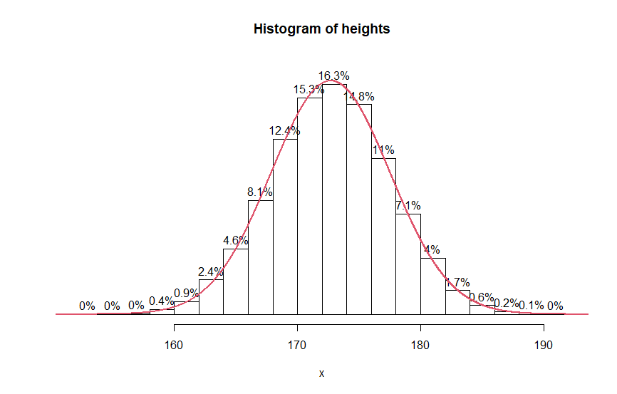

Slide 11
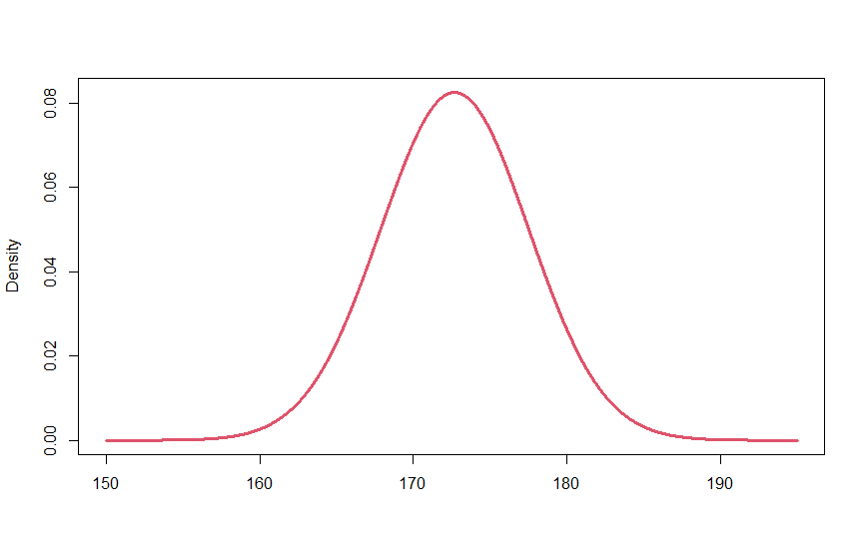

Slide 12
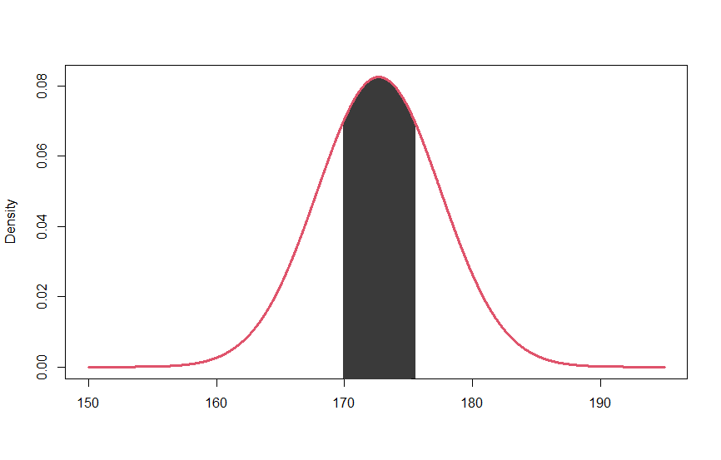

Slide 13
What to remember
What is a histogram: Frequency plot
Values in our data are always distributed in a certain way
A distribution has a density function
We get the probability that a random data point takes a value from a certain range if we calculate the are under the according density function

Slide 15
What to remember
What is a histogram: Frequency plot
Values in our data are always distributed in a certain way
A distribution has a density function
We get the probability that a random data point takes
a value from a certain range if we calculate the are under
the according density function

